Slide 1
Unsupervised ML
Learning Patterns from Unlabeled Data

Slide 2
Unsupervised ML Agenda
Unsupervised Learning
Motivation and Application
Categories
Clustering
Association
Dimensionality Reduction
Clustering
K-means
DBSCAN
Hierarchical Clustering
Comparison
Association
Apriori
Dimensionality Reduction
PCA

Slide 3
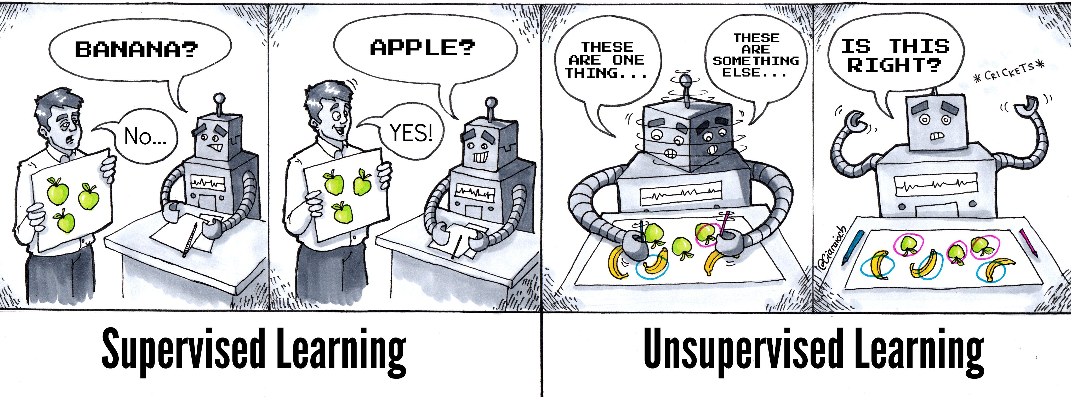
Source: https://twitter.com/athena_schools/status/1063013435779223553/photo/1

Slide 4
Unsupervised ML Agenda
Unsupervised Learning
Motivation and Application
Categories
Clustering
Association
Dimensionality Reduction
Clustering
K-means
DBSCAN
Hierarchical Clustering
Comparison
Association
Apriori
Dimensionality Reduction
PCA

Slide 5
Unsupervised ML – Motivation & Application
Unsupervised learning uses machine learning algorithms to analyze unlabeled datasets by discovering hidden patterns or data clusters without having any external guidance.
Unsupervised learning can discover hidden patterns without labels. It is thus easier or less costly for analyzing complex problems compared to supervised learning.
Sample applications:
data analysis
cross-selling strategies
recommender systems
customer segmentation
marketing campaign
and image recognition.
What is Unsupervised Learning
Motivation and Application

Slide 6
Unsupervised ML Agenda
Unsupervised Learning
Motivation and Application
Categories
Clustering
Association
Dimensionality Reduction
Clustering
K-means
DBSCAN
Hierarchical Clustering
Comparison
Association
Apriori
Dimensionality Reduction
PCA

Slide 7
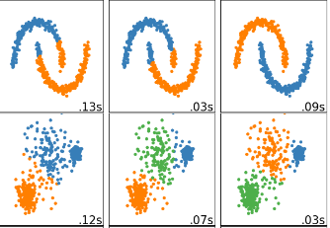
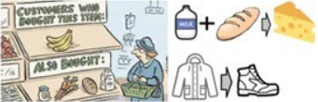
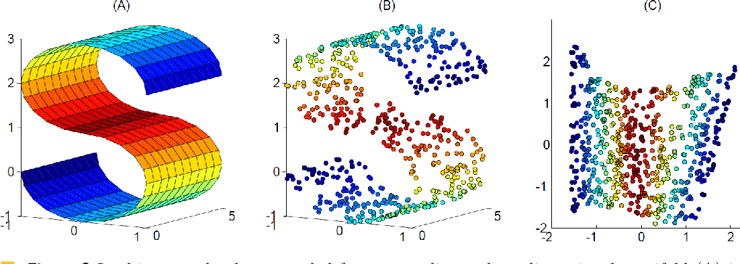
Unsupervised ML – Categories
The task of dividing the data points into groups such that data points within the same group are more similar than those in other groups.
An association rule is an unsupervised learning method which is used for discovering the relationships between variables hidden in large datasets. Those relationships are usually represented in form of rules or frequent item-sets.
The goal is to summarize the data to a reduced number of dimensions (variables). It is often used to visualize data, or to transform data during pre-processing phase for supervised learning.
Clustering
Association
Dimensionality Reduction
http://scikit-learn.org/stable/modules/clustering.html
https://ekalaiva-ai.com/home/types-ml.html
https://www.semanticscholar.org/paper/A-Survey-of-Dimension-Reduction-Methods-for-Data-Engel-H%C3%BCttenberger/8dc7a7af1685d6667d24f013ecc5fceeb2bcc689

Slide 8
Unsupervised ML Agenda
Unsupervised Learning
Motivation and Application
Categories
Clustering
Association
Dimensionality Reduction
Clustering
K-means
DBSCAN
Hierarchical Clustering
Comparison
Association
Apriori
Dimensionality Reduction
PCA

Slide 9
Unsupervised ML – Clustering K-means Algorithm
K-means
Steps:
Select k, which is the cluster number
Randomly initialize k centroids (select k distinct data points randomly)
Assign data points to the nearest initial centroid based on their distances
Update the new centroids from calculating the data point mean
Repeat steps from 3&4
k=3

Slide 10
Unsupervised ML – Clustering K-means Algorithm
K-means
Steps:
Select k, which is the cluster number
Randomly initialize k centroids (select k distinct data points randomly)
Assign data points to the nearest initial centroid based on their distances
Update the new centroids from calculating the data point mean
Repeat steps from 3&4

Slide 11
Unsupervised ML – Clustering K-means Algorithm
K-means
Steps:
Select k, which is the cluster number
Randomly initialize k centroids (select k distinct data points randomly)
Assign data points to the nearest initial centroid based on their distances
Update the new centroids from calculating the data point mean
Repeat steps from 3&4

Slide 12
Unsupervised ML – Clustering K-means Algorithm
K-means
Steps:
Select k, which is the cluster number
Randomly initialize k centroids (select k distinct data points randomly)
Assign data points to the nearest initial centroid based on their distances
Update the new centroids from calculating the data point mean
Repeat steps from 3&4

Slide 13
Unsupervised ML – Clustering K-means Algorithm
K-means
Steps:
Select k, which is the cluster number
Randomly initialize k centroids (select k distinct data points randomly)
Assign data points to the nearest initial centroid based on their distances
Update the new centroids from calculating the data point mean
Repeat steps from 3&4, until the cluster assignment does not change

Slide 14
Unsupervised ML – Clustering K-means Algorithm
K-means
Steps:
Select k, which is the cluster number
Randomly initialize k centroids (select k distinct data points randomly)
Assign data points to the nearest initial centroid based on their distances
Update the new centroids from calculating the data point mean
Repeat steps from 3&4, until the cluster assignment does not change
How to evaluate clustering results?
Total variation within clusters

Slide 15
Unsupervised ML – Clustering K-means Algorithm
Total variation within clusters
Total variation within clusters

Slide 16
Unsupervised ML – Clustering K-means Algorithm
K-means
How to choose k?
k=1
Total variation within clusters
k=2
k=3

Slide 17
Unsupervised ML – Clustering K-means Algorithm
K-means
How to choose k?
Total variation within clusters
Elbow Point

Slide 18
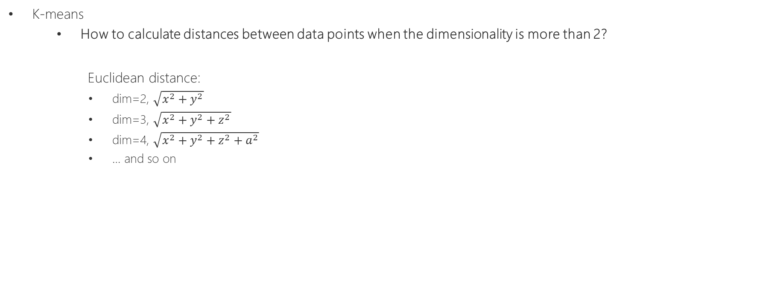
Unsupervised ML – Clustering K-means Algorithm
K-means
How to calculate distances between data points when the dimensionality is more than 2?
Euclidean distance:
dim=2, $\sqrt{x^{2}+y^{2}}$
dim=3, $\sqrt{x^{2}+y^{2}+z^{2}}$
dim=4, $\sqrt{x^{2}+y^{2}+z^{2}+a^{2}}$
… and so on

Slide 19
Unsupervised ML Agenda
Unsupervised Learning
Motivation and Application
Categories
Clustering
Association
Dimensionality Reduction
Clustering
K-means
DBSCAN
Hierarchical Clustering
Comparison
Association
Apriori
Dimensionality Reduction
PCA

Slide 20
Unsupervised ML – Clustering DBSCAN Algorithm
DBSCAN
Density-Based Spatial Clustering of Applications with Noise
Concept:
Density Reachability: identify a point A to be reachable from another point B by checking if A lies within a particular distance (eps) from B
Density Connectivity: determine whether points are located in a particular cluster by chaining-approach. For example, point A and point B can be connected if A->X->Y->B, where A->X means X is a neighborhood point of A
Parameters:
eps (ε): Distance measure for finding neighborhood points
minPts: Minimum number of points to identify if a region is considered dense

Slide 21
Unsupervised ML – Clustering DBSCAN Algorithm
DBSCAN
Steps:
Identify core points and none-core points by eps and minPts
Form a cluster from a randomly selected core point by
Adding the neighborhood core points into the cluster
Expanding the cluster by chaining the neighborhood core points of those core points
Assign none-core points to a cluster if it is a neighborhood point of one of the core points in that cluster
Repeat step 2-3, until all core points are assigned to a cluster
The resting none-core points are outliers
eps
minPts=4

Slide 22
Unsupervised ML – Clustering DBSCAN Algorithm
DBSCAN
Steps:
Identify core points and none-core points by eps and minPts
Form a cluster from a randomly selected core point by
Adding the neighborhood core points into the cluster
Expanding the cluster by chaining the neighborhood core points of those core points
Assign none-core points to a cluster if it is a neighborhood point of one of the core points in that cluster
Repeat step 2-3, until all core points are assigned to a cluster
The resting none-core points are outliers
eps
minPts=4

Slide 23
Unsupervised ML – Clustering DBSCAN Algorithm
DBSCAN
Steps:
Identify core points and none-core points by eps and minPts
Form a cluster from a randomly selected core point by
Adding the neighborhood core points into the cluster
Expanding the cluster by chaining the neighborhood core points of those core points
Assign none-core points to a cluster if it is a neighborhood point of one of the core points in that cluster
Repeat step 2-3, until all core points are assigned to a cluster
The resting none-core points are outliers
Core point
None-core point

Slide 24
Unsupervised ML – Clustering DBSCAN Algorithm
DBSCAN
Steps:
Identify core points and none-core points by eps and minPts
Form a cluster from a randomly selected core point by
Adding the neighborhood core points into the cluster
Expanding the cluster by chaining the neighborhood core points of those core points
Assign none-core points to a cluster if it is a neighborhood point of one of the core points in that cluster
Repeat step 2-3, until all core points are assigned to a cluster
The resting none-core points are outliers
Start core point
Core point
None-core point
Cluster1

Slide 25
Unsupervised ML – Clustering DBSCAN Algorithm
DBSCAN
Steps:
Identify core points and none-core points by eps and minPts
Form a cluster from a randomly selected core point by
Adding the neighborhood core points into the cluster
Expanding the cluster by chaining the neighborhood core points of those core points
Assign none-core points to a cluster if it is a neighborhood point of one of the core points in that cluster
Repeat step 2-3, until all core points are assigned to a cluster
The resting none-core points are outliers
Start core point
Core point
None-core point
Cluster1

Slide 26
Unsupervised ML – Clustering DBSCAN Algorithm
DBSCAN
Steps:
Identify core points and none-core points by eps and minPts
Form a cluster from a randomly selected core point by
Adding the neighborhood core points into the cluster
Expanding the cluster by chaining the neighborhood core points of those core points
Assign none-core points to a cluster if it is a neighborhood point of one of the core points in that cluster
Repeat step 2-3, until all core points are assigned to a cluster
The resting none-core points are outliers
Start core point
Core point
None-core point
Cluster1

Slide 27
Unsupervised ML – Clustering DBSCAN Algorithm
DBSCAN
Steps:
Identify core points and none-core points by eps and minPts
Form a cluster from a randomly selected core point by
Adding the neighborhood core points into the cluster
Expanding the cluster by chaining the neighborhood core points of those core points
Assign none-core points to a cluster if it is a neighborhood point of one of the core points in that cluster
Repeat step 2-3, until all core points are assigned to a cluster
The resting none-core points are outliers
Start core point
Core point
None-core point
Cluster1

Slide 28
Unsupervised ML – Clustering DBSCAN Algorithm
DBSCAN
Steps:
Identify core points and none-core points by eps and minPts
Form a cluster from a randomly selected core point by
Adding the neighborhood core points into the cluster
Expanding the cluster by chaining the neighborhood core points of those core points
Assign none-core points to a cluster if it is a neighborhood point of one of the core points in that cluster
Repeat step 2-3, until all core points are assigned to a cluster
The resting none-core points are outliers
Start core point
Core point
None-core point
Cluster1

Slide 29
Unsupervised ML – Clustering DBSCAN Algorithm
DBSCAN
Steps:
Identify core points and none-core points by eps and minPts
Form a cluster from a randomly selected core point by
Adding the neighborhood core points into the cluster
Expanding the cluster by chaining the neighborhood core points of those core points
Assign none-core points to a cluster if it is a neighborhood point of one of the core points in that cluster
Repeat step 2-3, until all core points are assigned to a cluster
The resting none-core points are outliers
Start core point
Core point
None-core point
Cluster1

Slide 30
Unsupervised ML – Clustering DBSCAN Algorithm
DBSCAN
Steps:
Identify core points and none-core points by eps and minPts
Form a cluster from a randomly selected core point by
Adding the neighborhood core points into the cluster
Expanding the cluster by chaining the neighborhood core points of those core points
Assign none-core points to a cluster if it is a neighborhood point of one of the core points in that cluster
Repeat step 2-3, until all core points are assigned to a cluster
The resting none-core points are outliers
Start core point
Core point
None-core point
Cluster1

Slide 31
Unsupervised ML – Clustering DBSCAN Algorithm
DBSCAN
Steps:
Identify core points and none-core points by eps and minPts
Form a cluster from a randomly selected core point by
Adding the neighborhood core points into the cluster
Expanding the cluster by chaining the neighborhood core points of those core points
Assign none-core points to a cluster if it is a neighborhood point of one of the core points in that cluster
Repeat step 2-3, until all core points are assigned to a cluster
The resting none-core points are outliers
Start core point
Core point
None-core point
Cluster1

Slide 32
Unsupervised ML – Clustering DBSCAN Algorithm
DBSCAN
Steps:
Identify core points and none-core points by eps and minPts
Form a cluster from a randomly selected core point by
Adding the neighborhood core points into the cluster
Expanding the cluster by chaining the neighborhood core points of those core points
Assign none-core points to a cluster if it is a neighborhood point of one of the core points in that cluster
Repeat step 2-3, until all core points are assigned to a cluster
The resting none-core points are outliers
Core point
None-core point
Cluster1
Cluster2
Start core point

Slide 33
Unsupervised ML – Clustering DBSCAN Algorithm
DBSCAN
Steps:
Identify core points and none-core points by eps and minPts
Form a cluster from a randomly selected core point by
Adding the neighborhood core points into the cluster
Expanding the cluster by chaining the neighborhood core points of those core points
Assign none-core points to a cluster if it is a neighborhood point of one of the core points in that cluster
Repeat step 2-3, until all core points are assigned to a cluster
The resting none-core points are outliers
Core point
None-core point
Cluster1
Cluster2
Start core point

Slide 34
Unsupervised ML – Clustering DBSCAN Algorithm
DBSCAN
Steps:
Identify core points and none-core points by eps and minPts
Form a cluster from a randomly selected core point by
Adding the neighborhood core points into the cluster
Expanding the cluster by chaining the neighborhood core points of those core points
Assign none-core points to a cluster if it is a neighborhood point of one of the core points in that cluster
Repeat step 2-3, until all core points are assigned to a cluster
The resting none-core points are outliers
Core point
None-core point
Cluster1
Cluster2
Start core point

Slide 35
Unsupervised ML – Clustering DBSCAN Algorithm
DBSCAN
Steps:
Identify core points and none-core points by eps and minPts
Form a cluster from a randomly selected core point by
Adding the neighborhood core points into the cluster
Expanding the cluster by chaining the neighborhood core points of those core points
Assign none-core points to a cluster if it is a neighborhood point of one of the core points in that cluster
Repeat step 2-3, until all core points are assigned to a cluster
The resting none-core points are outliers
Core point
None-core point
Cluster1
Cluster2
Start core point

Slide 36
Unsupervised ML – Clustering DBSCAN Algorithm
DBSCAN
Steps:
Identify core points and none-core points by eps and minPts
Form a cluster from a randomly selected core point by
Adding the neighborhood core points into the cluster
Expanding the cluster by chaining the neighborhood core points of those core points
Assign none-core points to a cluster if it is a neighborhood point of one of the core points in that cluster
Repeat step 2-3, until all core points are assigned to a cluster
The resting none-core points are outliers
Core point
None-core point
Cluster1
Cluster2
Outlier

Slide 37
Unsupervised ML Agenda
Unsupervised Learning
Motivation and Application
Categories
Clustering
Association
Dimensionality Reduction
Clustering
K-means
DBSCAN
Hierarchical Clustering
Comparison
Association
Apriori
Dimensionality Reduction
PCA

Slide 38
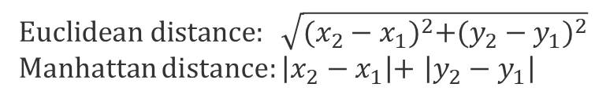
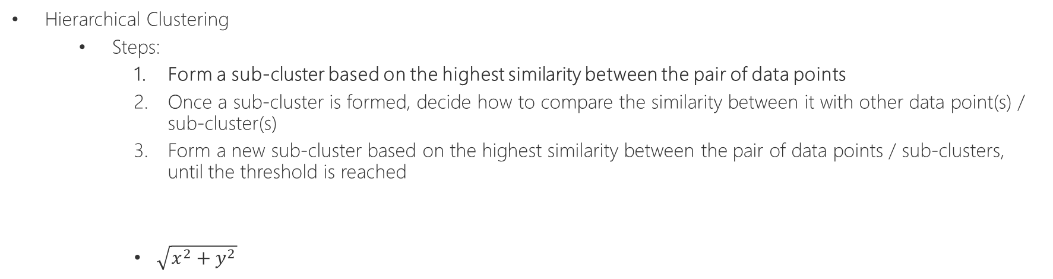
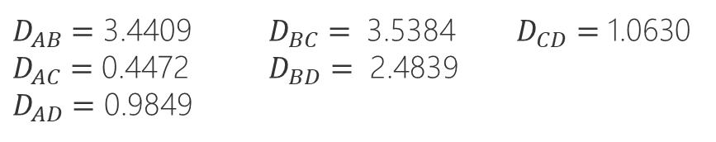
Unsupervised ML – Clustering Hierarchical Clustering Algorithm
Hierarchical Clustering
Steps:
Form a sub-cluster based on the highest similarity between the pair of data points
Once a sub-cluster is formed, decide how to compare the similarity between it with other data point(s) / sub-cluster(s)
Form a new sub-cluster based on the highest similarity between the pair of data points / sub-clusters, until the threshold is reached
$\sqrt{x^{2}+y^{2}}$
 | x | y
Point A | 1.2 | -0.6
Point B | -0.8 | 2.2
Point C | 1.6 | -0.4
Point D | 0.8 | 0.3
$$Euclidean distance: \sqrt{{({x_{2}−x}_{1})}^{2}+({y_{2}−y}_{1})^{2}}$$
Manhattan distance: $\left|{x_{2}−x}_{1}\right|$+ $\left|{y_{2}−y}_{1}\right|$
$D_{AB}=$ 3.4409 $D_{BC}=$ 3.5384 $D_{CD}=$ 1.0630
$D_{AC}=$ 0.4472 $D_{BD}=$ 2.4839
$D_{AD}=$ 0.9849

Slide 39
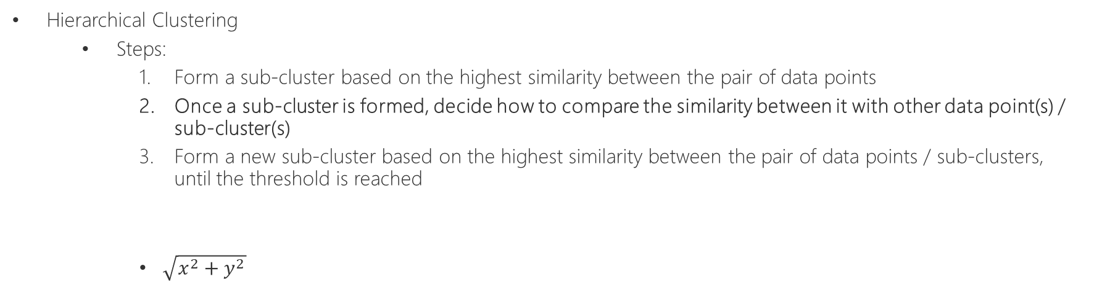
Unsupervised ML – Clustering Hierarchical Clustering Algorithm
Hierarchical Clustering
Steps:
Form a sub-cluster based on the highest similarity between the pair of data points
Once a sub-cluster is formed, decide how to compare the similarity between it with other data point(s) / sub-cluster(s)
Form a new sub-cluster based on the highest similarity between the pair of data points / sub-clusters, until the threshold is reached
$\sqrt{x^{2}+y^{2}}$
 | x | y
Sub-cluster1 | 1.2 | -0.6
Point C | 1.6 | -0.4
Point B | -0.8 | 2.2
Point D | 0.8 | 0.3
Similarity measurement between sub-cluster and other data point / sub-cluster:
Centroid: average of cluster points
Single-linkage: furthest point
Complete-linkage: closest point

Slide 40
Unsupervised ML – Clustering Hierarchical Clustering Algorithm
Centroid Single-linkage Complete-linkage
 | x | y
Sub-cluster1 | 1.2 | -0.6
Point C | 1.6 | -0.4
Point B | -0.8 | 2.2
Point D | 0.8 | 0.3
Similarity measurement between sub-cluster and other data point / sub-cluster:
Centroid: average of cluster points
Single-linkage: furthest point
Complete-linkage: closest point

Slide 41
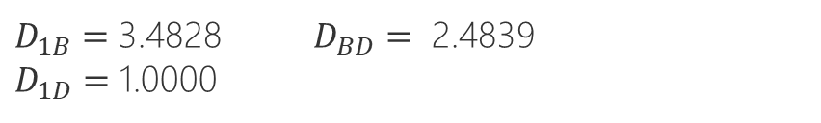
Unsupervised ML – Clustering Hierarchical Clustering Algorithm
Hierarchical Clustering
Steps:
Form a sub-cluster based on the highest similarity between the pair of data points
Once a sub-cluster is formed, decide how to compare the similarity between it with other data point(s) / sub-cluster(s)
Form a new sub-cluster based on the highest similarity between the pair of data points / sub-clusters, until the threshold is reached
 | x | y
Sub-cluster1 | 1.4 | -0.5
Point B | -0.8 | 2.2
Point D | 0.8 | 0.3
$D_{1B}=$ 3.4828 $D_{BD}=$ 2.4839
$D_{1D}=$ 1.0000

Slide 42
Unsupervised ML – Clustering Hierarchical Clustering Algorithm
Hierarchical Clustering
Steps:
Form a sub-cluster based on the highest similarity between the pair of data points
Once a sub-cluster is formed, decide how to compare the similarity between it with other data point(s) / sub-cluster(s)
Form a new sub-cluster based on the highest similarity between the pair of data points / sub-clusters, until the threshold is reached
 | x | y
Sub-cluster1 | 1.4 | -0.5
Point D | 0.8 | 0.3
Point B | -0.8 | 2.2
$D_{1B}=$ 3.4828 $D_{BD}=$ 2.4839
$D_{1D}=$ 1.0000

Slide 43
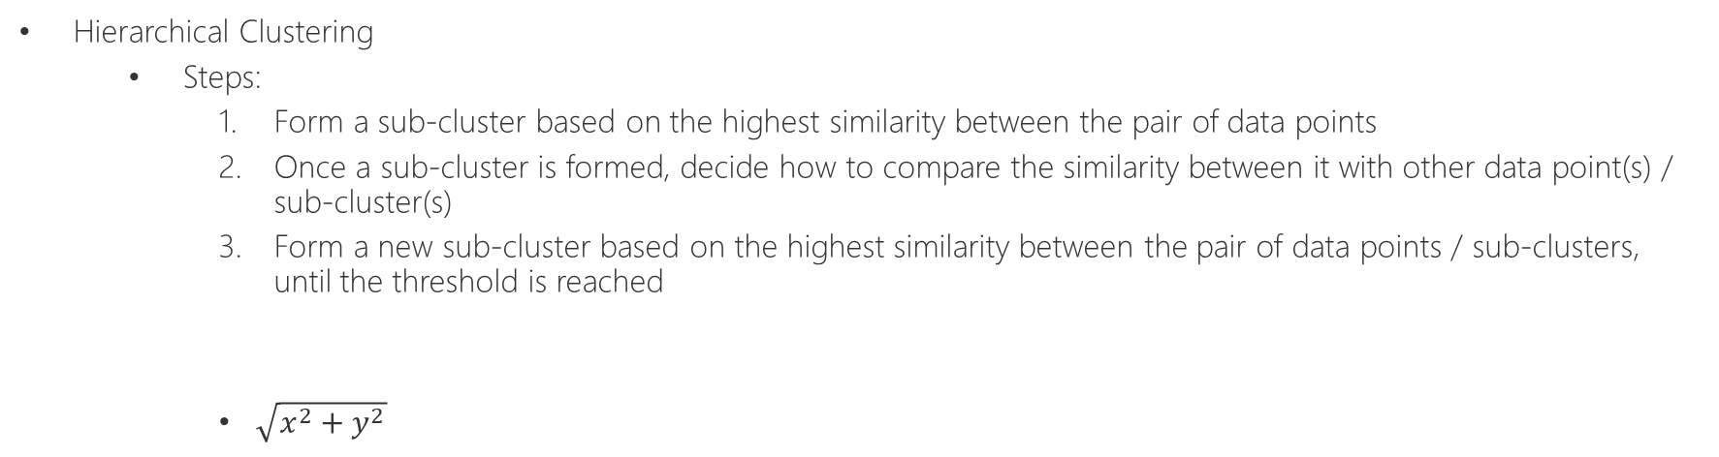
Unsupervised ML – Clustering Hierarchical Clustering Algorithm
Hierarchical Clustering
Steps:
Form a sub-cluster based on the highest similarity between the pair of data points
Once a sub-cluster is formed, decide how to compare the similarity between it with other data point(s) / sub-cluster(s)
Form a new sub-cluster based on the highest similarity between the pair of data points / sub-clusters, until the threshold is reached
$\sqrt{x^{2}+y^{2}}$
 | x | y
Point A | 1.2 | -0.6
Point C | 1.6 | -0.4
Point D | 0.8 | 0.3
Point B | -0.8 | 2.2
Dendrogram:
hight of the branches indicates the similarity

Slide 44
Unsupervised ML Agenda
Unsupervised Learning
Motivation and Application
Categories
Clustering
Association
Dimensionality Reduction
Clustering
K-means
DBSCAN
Hierarchical Clustering
Comparison
Association
Apriori
Dimensionality Reduction
PCA

Slide 45
Unsupervised ML – Clustering Clustering Algorithms Comparison
Criteria | K-means | DBSCAN | Hierarchal Clustering
Initial Condition | Yes | Yes | No
Termination Condition | Precise | Precise | Not precise
Data Type | Numeric attribute | Numeric attribute | arbitrary
Shape of Data | Convex | Arbitrary | Arbitrary
Handeling Dynamic Data | Yes | Yes | No
Influence by Noise | High | Not much | No

Slide 46
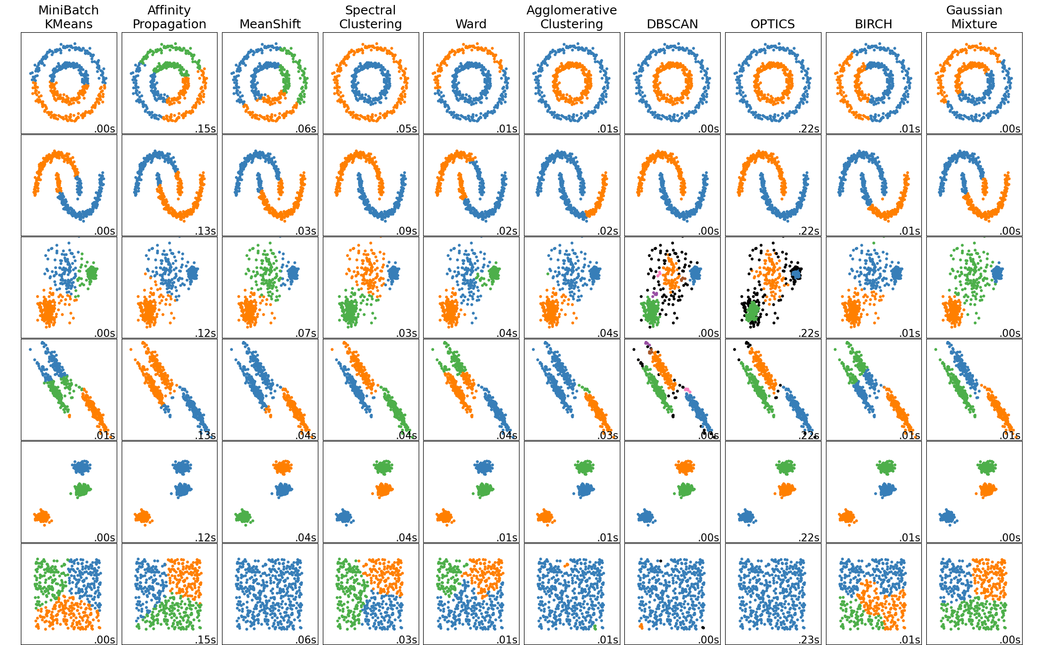
Unsupervised ML – Clustering Clustering Algorithms Comparison
Source: https://scikit-learn.org/stable/modules/clustering.html

Slide 47
Unsupervised ML Agenda
Unsupervised Learning
Motivation and Application
Categories
Clustering
Association
Dimensionality Reduction
Clustering
K-means
DBSCAN
Hierarchical Clustering
Comparison
Association
Apriori
Dimensionality Reduction
PCA

Slide 48









Unsupervised ML – Association Apriori Algorithm
Apriori Algorithm
One of the original algorithms for building association rules, which can be thought of as an if-then relationship
One of the popular applications: Market Basket Analysis
A ⇒ B
if then
Discount

Slide 49
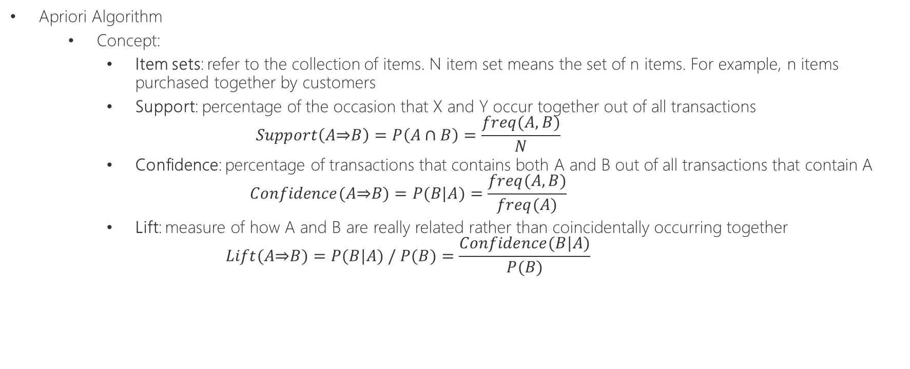
Unsupervised ML – Association Apriori Algorithm
Apriori Algorithm
Concept:
Item sets: refer to the collection of items. N item set means the set of n items. For example, n items purchased together by customers
Support: percentage of the occasion that X and Y occur together out of all transactions
$$Support\left(A\text{⇒}B\right)=P\left(A∩B\right)=\frac{freq(A,B)}{N}$$
Confidence: percentage of transactions that contains both A and B out of all transactions that contain A
$$Confidence(A\text{⇒}B)=P(B|A)=\frac{freq(A,B)}{freq(A)}$$
Lift: measure of how A and B are really related rather than coincidentally occurring together
$$Lift(A\text{⇒}B)=P(B|A) / P(B)=\frac{Confidence(B|A)}{P(B)}$$

Slide 50
Unsupervised ML – Association Apriori Algorithm
Apriori Algorithm
Concept:
Item sets: refer to the collection of items. N item set means the set of n items. For example, n items purchased together by customers
Support: percentage of the occasion that X and Y occur together out of all transactions
$$Support\left(A\text{⇒}B\right)=P\left(A∩B\right)=\frac{freq(A,B)}{N}$$
Confidence: percentage of transactions that contains both A and B out of all transactions that contain A
$$Confidence(A\text{⇒}B)=P(B|A)=\frac{freq(A,B)}{freq(A)}$$
Lift: measure of how A and B are really related rather than coincidentally occurring together
$$Lift(A\text{⇒}B)=P(B|A) / P(B)=\frac{Confidence(B|A)}{P(B)}$$
T1 | A | B | C
T2 | A | C | E
T3 | B | C | D
T4 | B | C | E
T5 | A | D | E
Rule | Support | Confidence | Lift
A⇒C | 2/5 | 2/3 | 10/9
C⇒A | 2/5 | 2/4 | 10/12
B&C⇒D | 1/5 | 1/3 | 5/9

Slide 51
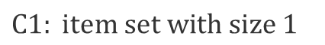
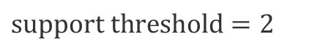
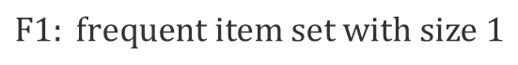
Unsupervised ML – Association Apriori Algorithm
Apriori Algorithm
Step 1: finding the frequent subsets
To create association rules, Apriori algorithm uses frequent item sets, whose frequency is more than the defined threshold value
Besides, a subset of a frequent item set must also be a frequent item set
Starting from size 1, we will find frequent item set incrementally
$$support threshold=2$$
$$C1: item set with size 1$$
$$F1: frequent item set with size 1$$
Transaction ID | Items
T1 | ACD
T2 | BCE
T3 | ABCE
T4 | BE
T5 | ACE
Item Set | Frequency
{A} | 3
{B} | 3
{C} | 4
{D} | 1
{E} | 4
Item Set | Frequency
{A} | 3
{B} | 3
{C} | 4
{E} | 4

Slide 52
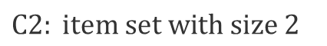
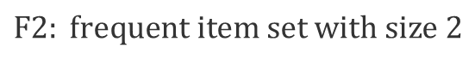
Unsupervised ML – Association Apriori Algorithm
Apriori Algorithm
Step 1: finding the frequent subsets
To create association rules, Apriori algorithm uses frequent item sets, whose frequency is more than the defined threshold value
Besides, a subset of a frequent item set must also be a frequent item set
Starting from size 1, we will find frequent item set incrementally
$$support threshold=2$$
$$C2: item set with size 2$$
$$F2: frequent item set with size 2$$
Transaction ID | Items
T1 | ACD
T2 | BCE
T3 | ABCE
T4 | BE
T5 | ACE
Item Set | Frequency
{A,B} | 1
{A,C} | 3
{A,E} | 2
{B,C} | 2
{B,E} | 3
{C,E} | 3
Item Set | Frequency
{A,C} | 3
{A,E} | 2
{B,C} | 2
{B,E} | 3
{C,E} | 3

Slide 53
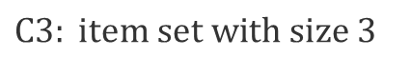

Unsupervised ML – Association Apriori Algorithm
Apriori Algorithm
Step 1: finding the frequent subsets
To create association rules, Apriori algorithm uses frequent item sets, whose frequency is more than the defined threshold value
Besides, a subset of a frequent item set must also be a frequent item set
Starting from size 1, we will find frequent item set incrementally
$$support threshold=2$$
$$C3: item set with size 3$$
$$F3: frequent item set with size 3$$
Transaction ID | Items
T1 | ACD
T2 | BCE
T3 | ABCE
T4 | BE
T5 | ACE
Item Set | Frequency
{A,B,C} | 1
{A,B,E} | 1
{A,C,E} | 2
{B,C,E} | 2
Item Set | Frequency
{A,C,E} | 2
{B,C,E} | 2

Slide 54
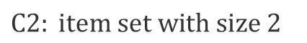
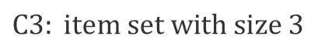
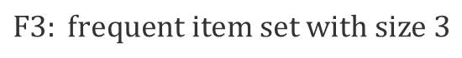
Unsupervised ML – Association Apriori Algorithm
Apriori Algorithm
Step 1: finding the frequent subsets
To create association rules, Apriori algorithm uses frequent item sets, whose frequency is more than the defined threshold value
Besides, a subset of a frequent item set must also be a frequent item set
Starting from size 1, we will find frequent item set incrementally
$$C3: item set with size 3$$
$$C2: item set with size 2$$
$$F3: frequent item set with size 3$$
Item Set | Size 2 Subset
{A,B,C} | {A,B}, {A,C}, {B,C}
{A,B,E} | {A,B}, {A,E}, {B,E}
{A,C,E} | {A,C}, {A,E}, {C,E}
{B,C,E} | {B,C}, {B,E}, {C,E}
Item Set | Frequency
{A,B} | 1
{A,C} | 3
{A,E} | 2
{B,C} | 2
{B,E} | 3
{C,E} | 3
Item Set | Frequency
{A,C,E} | 2
{B,C,E} | 2

Slide 55
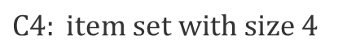
Unsupervised ML – Association Apriori Algorithm
Apriori Algorithm
Step 1: finding the frequent subsets
To create association rules, Apriori algorithm uses frequent item sets, whose frequency is more than the defined threshold value
Besides, a subset of a frequent item set must also be a frequent item set
Starting from size 1, we will find frequent item set incrementally
$$support threshold=2$$
$$C4: item set with size 4$$
Transaction ID | Items
T1 | ACD
T2 | BCE
T3 | ABCE
T4 | BE
T5 | ACE
Item Set | Frequency
{A,B,C,E} | 1

Slide 56

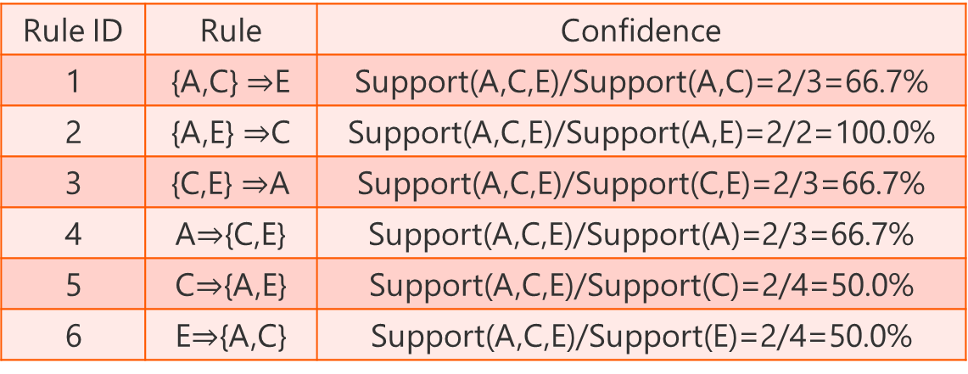
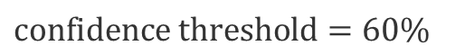

Unsupervised ML – Association Apriori Algorithm
Apriori Algorithm
Step 2: finding strong association rules
Filter the rules and keep only those whose confidence is more than the defined threshold value
$$confidence threshold=60\%$$
$$example of \{A,C,E\}$$
Transaction ID | Items
T1 | ACD
T2 | BCE
T3 | ABCE
T4 | BE
T5 | ACE
Rule ID | Rule | Confidence
1 | {A,C} $\text{⇒}$E | Support(A,C,E)/Support(A,C)=2/3=66.7%
2 | {A,E} $\text{⇒}$C | Support(A,C,E)/Support(A,E)=2/2=100.0%
3 | {C,E} $\text{⇒}$A | Support(A,C,E)/Support(C,E)=2/3=66.7%
4 | A$\text{⇒}${C,E} | Support(A,C,E)/Support(A)=2/3=66.7%
5 | C$\text{⇒}${A,E} | Support(A,C,E)/Support(C)=2/4=50.0%
6 | E$\text{⇒}${A,C} | Support(A,C,E)/Support(E)=2/4=50.0%
rejected
rejected

Slide 57
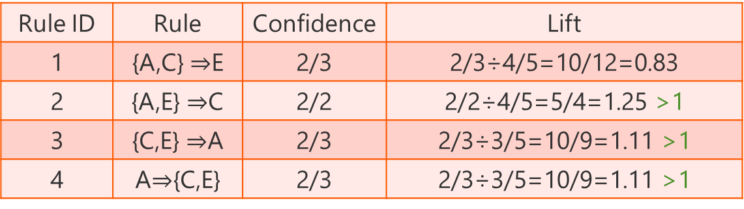
Unsupervised ML – Association Apriori Algorithm
Apriori Algorithm
(Step 3): (optional) evaluate if rules are strong
Calculate the lift value to see if rules are strong instead of happening occasionally
$$confidence threshold=60\%$$
$$example of \{A,C,E\}$$
Transaction ID | Items
T1 | ACD
T2 | BCE
T3 | ABCE
T4 | BE
T5 | ACE
Rule ID | Rule | Confidence | Lift
1 | {A,C} $\text{⇒}$E | 2/3 | 2/3÷4/5=10/12=0.83
2 | {A,E} $\text{⇒}$C | 2/2 | 2/2÷4/5=5/4=1.25 >1
3 | {C,E} $\text{⇒}$A | 2/3 | 2/3÷3/5=10/9=1.11 >1
4 | A$\text{⇒}${C,E} | 2/3 | 2/3÷3/5=10/9=1.11 >1
strong
strong
strong

Slide 58
Unsupervised ML Agenda
Unsupervised Learning
Motivation and Application
Categories
Clustering
Association
Dimensionality Reduction
Clustering
K-means
DBSCAN
Hierarchical Clustering
Comparison
Association
Apriori
Dimensionality Reduction
PCA

Slide 59
Unsupervised ML – Dimensionality Reduction PCA
PCA - Principal Component Analysis
Motivation
Data Compression: by summarizing the data to a reduced number of dimensions, we may achieve better performance in speed or model accuracy
Visualization: it’s hard for humans to imagine data distribution with more than 3 dimensions
PCA is unsupervised because it does not apply any labels in the computation.
Steps
Standardize the dataset
Calculate the covariance matrix for the features in the dataset
Calculate the eigenvalues and eigenvectors for the covariance matrix
Sort eigenvalues and their corresponding eigenvectors
Pick top k eigenvalues and form a matrix from their corresponding eigenvectors
Transform the original matrix

Slide 60
Unsupervised ML – Dimensionality Reduction PCA
PCA - Principal Component Analysis
 | Virus1 | Virus2 | Virus3 | Virus4 | Virus5 | Virus6
Compound1 | 6 | 3 | 6 | 7 | 5 | 2
Compound2 | 3 | 2 | 2 | 2 | 9 | 6
Compound3 | 8 | 4 | 7 | 2 | 10 | 2
Compound2
Compound3
Compound1

Slide 61
Unsupervised ML – Dimensionality Reduction PCA
PCA - Principal Component Analysis
 | Virus1 | Virus2 | Virus3 | Virus4 | Virus5 | Virus6
Compound1 | 6 | 3 | 6 | 7 | 5 | 2
Compound2 | 3 | 2 | 2 | 1 | 9 | 6
Compound3 | 8 | 4 | 7 | 2 | 10 | 2
Compound4 | 2 | 6 | 3 | 8 | 5 | 4
Compound2
Compound3
? How to visualize when there are 4 compounds (variables)?
Compound1

Slide 62
Unsupervised ML – Dimensionality Reduction PCA
PCA - Principal Component Analysis
Find the mean and shift data so that the origin is overlapped with the mean of data.
 | Virus1 | Virus2 | Virus3 | Virus4 | Virus5 | Virus6
Compound1 | 6 | 2 | 8 | 7 | 2 | 1
Compound2 | 3 | 7 | 2 | 1 | 9 | 6
Compound2
Compound1

Slide 63
Unsupervised ML – Dimensionality Reduction PCA
PCA - Principal Component Analysis
Fit a line passing through the origin to the data.
When the line fits better, the sum of distances between that line and the data points gets less.
 | Virus1 | Virus2 | Virus3 | Virus4 | Virus5 | Virus6
Compound1 | 6 | 2 | 8 | 7 | 2 | 1
Compound2 | 3 | 7 | 2 | 1 | 9 | 6
Compound2
Compound1

Slide 64
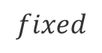
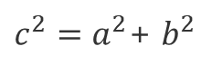

Unsupervised ML – Dimensionality Reduction PCA
PCA - Principal Component Analysis
On the other hand, it means when the line fits at most, the sum of distances between the origin and the projected points are maximized.
 | Virus1 | Virus2 | Virus3 | Virus4 | Virus5 | Virus6
Compound1 | 6 | 2 | 8 | 7 | 2 | 1
Compound2 | 3 | 7 | 2 | 1 | 9 | 6
Compound2
$$↓ ↑$$
$c^{2}=a^{2}$+ $b^{2}$
$$fixed$$
Compound1
b
c
a

Slide 65
Unsupervised ML – Dimensionality Reduction PCA
PCA - Principal Component Analysis
Ultimately, the best fitting line will have the largest sum of squared distances between the origin and the projected points .
This line is principal component 1 (PC1.)
 | Virus1 | Virus2 | Virus3 | Virus4 | Virus5 | Virus6
Compound1 | 6 | 2 | 8 | 7 | 2 | 1
Compound2 | 3 | 7 | 2 | 1 | 9 | 6
Compound2
Compound1

Slide 66
Unsupervised ML – Dimensionality Reduction PCA
PCA - Principal Component Analysis
The slope of PC1 indicates it is a recipe (linear combination) of the original variables.
E.g. slope = -5/4 indicates -4 portion of Compound1 mixed with 5 portion of Compound2.
 | Virus1 | Virus2 | Virus3 | Virus4 | Virus5 | Virus6
Compound1 | 6 | 2 | 8 | 7 | 2 | 1
Compound2 | 3 | 7 | 2 | 1 | 9 | 6
Compound2
5
-4
Compound1

Slide 67
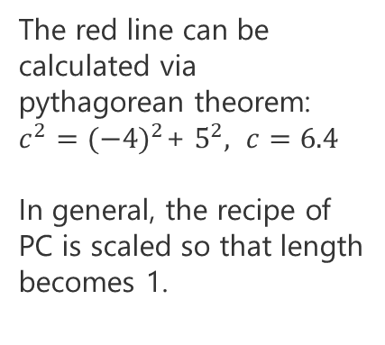
Unsupervised ML – Dimensionality Reduction PCA
PCA - Principal Component Analysis
The red line can be calculated via pythagorean theorem:
$c^{2}={(−4)}^{2}$+ $5^{2}, c=6.4$
In general, the recipe of PC is scaled so that length becomes 1.
 | Virus1 | Virus2 | Virus3 | Virus4 | Virus5 | Virus6
Compound1 | 6 | 2 | 8 | 7 | 2 | 1
Compound2 | 3 | 7 | 2 | 1 | 9 | 6
Compound2
5
-4
Compound1
5/6.4=0.781
6.4/6.4=1
To make one unit of PC1, mix -0.625 portion Compound1
with 0.781 portion Compound2
-4/6.4=-0.625

Slide 68
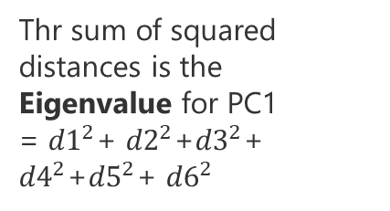
Unsupervised ML – Dimensionality Reduction PCA
PCA - Principal Component Analysis
Thr sum of squared distances is the Eigenvalue for PC1
= ${d1}^{2}$+ ${d2}^{2}$+${d3}^{2}$+ ${d4}^{2}$+${d5}^{2}$+ ${d6}^{2}$
Compound2
d3
d2
d1
d6
The 1 unit long red vector is the Eigenvector for PC1.
d5
d4
Compound1
5/6.4=0.781
6.4/6.4=1
To make one unit of PC1, mix -0.625 portion Compound1
with 0.781 portion Compound2
-4/6.4=-0.625

Slide 69
Unsupervised ML – Dimensionality Reduction PCA
PCA - Principal Component Analysis
PC2 is selected via the best fitting line that is perpendicular to PC1.
 | Virus1 | Virus2 | Virus3 | Virus4 | Virus5 | Virus6
Compound1 | 6 | 2 | 8 | 7 | 2 | 1
Compound2 | 3 | 7 | 2 | 1 | 9 | 6
Compound2
Compound1
6.4/6.4=1
4/6.4=0.625
To make one unit of PC2, mix 0.781 portion Compound1
with 0.625 portion Compound2
5/6.4=0.781

Slide 70
Unsupervised ML – Dimensionality Reduction PCA
PCA - Principal Component Analysis
PC2
Sum of squared distances for PC1 = Eigenvalue for PC1
Sum of squared distances for PC2 = Eigenvalue for PC2
PC1
Rotate everything so that PC1 is horizontal. Now we have data projected to the new space.

Slide 71
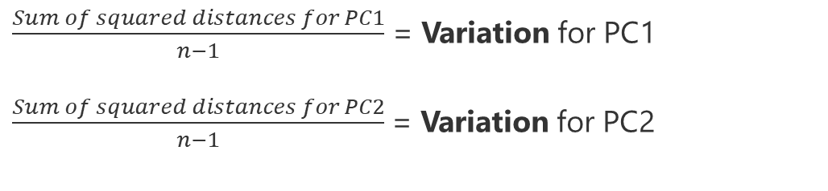
Unsupervised ML – Dimensionality Reduction PCA
PCA - Principal Component Analysis
PC2
$\frac{Sum of squared distances for PC1}{n−1}$ = Variation for PC1
$\frac{Sum of squared distances for PC2}{n−1}$= Variation for PC2
PC1
Suppose
variation for PC1=15, variation for PC2=5.
That means PC1 accounts for 15/(15+5)=75% of the total variation.
Rotate everything so that PC1 is horizontal. Now we have data projected to the new space.

Slide 72
Unsupervised ML – Dimensionality Reduction PCA
PCA - Principal Component Analysis
Now suppose we have higher dimentional data and 4 PCs where
variation for PC1 account for 79%
variation for PC2 account for 14%
variation for PC3 account for 5%
variation for PC4 account for 2%
That means using 2D with only PC1 and PC2 can speak for 93% of the total variation, which is a good enough approximation.

Slide 73
Unsupervised ML – Outlier Detection
Outlier Detection
Motivation
Algorithms
Multivariate Gaussian Distribution
One-Class SVM

Slide 74
Demo: Unsupervised Learning

